Slide 1
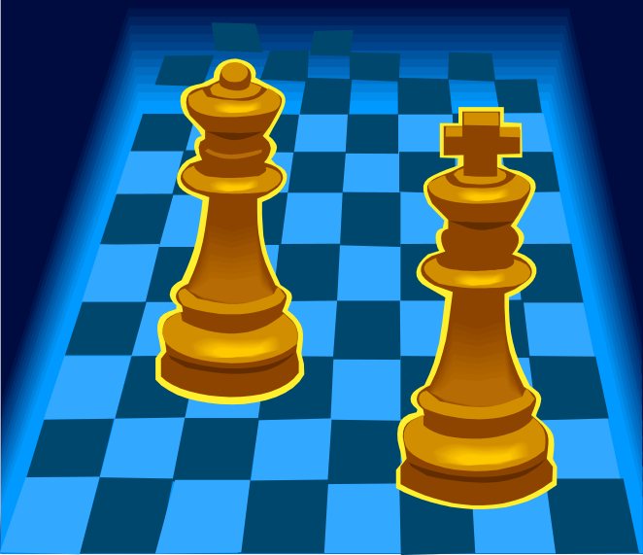
Basic Game Playing
Multiplayer Games & Prediction Techniques

Slide 2
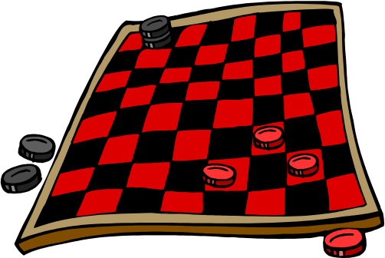
Multiplayer Games
Overview
We cannot apply standard search techniques to multiplayer games because we do not exclusively control the state of the problem (game). Game playing techniques let us predict the actions of other agents.
Multiplayer games come in two main variants: symmetric games (players have the same abilities) and asymmetric games (players have different abilities.)
Examples of Symmetric Games:
Real-Time: Doom, Warcraft (Original)
Turn-Based: Go, Settlers, Poker, Magic, Civilization
Examples of Asymmetric Games:
Real-Time: StarCraft, GoldenEye, Street Fighter II
Turn-Based: Final Fantasy, Civilization III

Slide 3
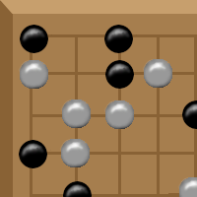
Game-Playing
Data Structures
Turn-based game playing is a well-defined problem. It has:
An initial state
A set of goal states
A set of reachable states
1+ Operators
Because of this, we can approach it using search techniques.
We’ll need a few data structures and functions to play games:
GameState class (contains information about pieces, cards, players, etc.)
Move class (represents a single move by a player in a game)
Terminal function (tells us when the game is over)
Evaluation function (tells of the value of the game’s state)

Slide 4
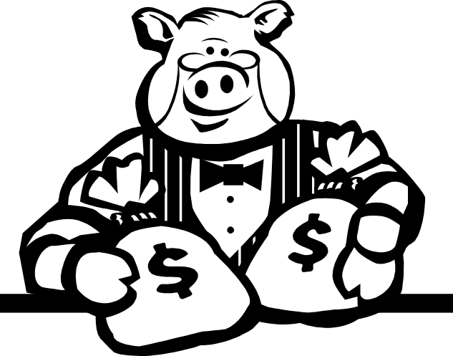
Game-Playing
The Greedy Method
The Greedy Method picks the move that yields the most immediately valuable game state.
Move Greedy(player, gameState)
{
Move bestMove = null;
GameState newState = new GameState();
generate valid Moves for player;
for each Move move:
{
newState.copy(gameState);
newState.apply(move);
move.rank = evaluate(newState);
if (!bestMove || move.rank betterThan bestMove.rank)
bestMove = move;
}
return bestMove;
}

Slide 5


Game-Playing
Greedy Method Analyzed
Greedy Method Benefits
Fast
Moderate Memory
Moderate CPU time
Greedy Method Drawbacks
Ignores opponent’s reaction
Short sighted

Slide 6



Prediction in Games
Often our predictions about other players are based on our perception of their rationality (the degree to which they use reasoning to make decisions.)
A perfectly rational agent…
Assumes that its opponents are perfectly rational
Uses this assumption to make a prediction of behaviors
Makes a reasoned decision based on those predictions

Slide 7
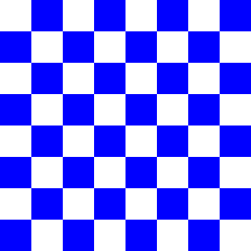
Game-Playing
The Minimax Method
The Minimax Method searches through several levels of moves, assuming the opponent always makes the best move available. It makes use of alpha-beta trees, also known as game trees.
Max
0
Min
A
0
A
-1
B
-1
B
0
C
D
A
B
0
1
0
0
-1
0
0
-1
0
0
1
0
D
D
C
C
D
D
C
C
D
D
C
C

Slide 8

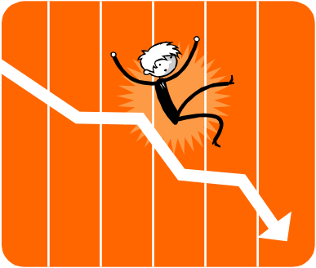
Game-Playing
The Minimax Algorithm
Move Minimax(player, gameState)
{
Move bestMove = null;
GameState newState = new GameState();
generate valid Moves for player;
for each Move move:
{
newState.copy(gameState);
newState.apply(move);
if (newState.isTerminal())
move.rank = evaluate(newState);
else
move.rank = Minimax(GetNextPlayer(), newState).rank;
if (!bestMove || move.rank is better than bestMove.rank)
bestMove = move;
}
return bestMove;
}

Slide 9
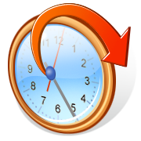

Game-Playing
Minimax: The Good and the Bad
Concerns with Minimax
Requires player order
Recursion to endgame
Unnecessary branching
No random capacity – dice, cards, etc.
Requires simulation capability
Mitigation Techniques
Player order logic
Depth limit check
Alpha-beta pruning
Negascout/PVS (better than α-β)
Chance nodes (expectiminimax)
Built-in simulator (at least for single moves)

Slide 10
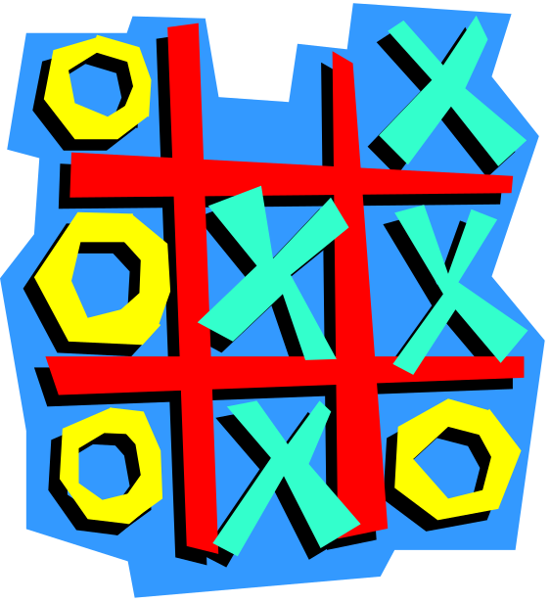

Game-Playing
Minimax Issue Mitigation
Player Order Logic (Forfeit Example)
We can incorporate the loss of a move by a player:
GetNextPlayer(player, gameState)
{
if (gameState.hasValidMove(-player))
return -player;
else
return player;
}
This allows Minimax to correctly consider forfeited moves.
(Note that this assumes “player” is a number.)
Depth Limit Check
We can prevent Minimax from running forever by providing a cutoff depth:
…
if (newState.isTerminal() || depth == depthLimit)
move.rank = evaluate(newState);
else
move.rank = Minimax(opponent, newState, depth + 1).rank;
…
This limits time but requires guesswork using a heuristic evaluation.

